Slide 1
Three-Month Sales Forecasting with Facebook Prophet
Presented by: Aman Khan, Data Scientist
Date: 29/10/2024

Slide 2
Project Overview
Objective: Forecast vehicle sales over the next three months by brand and model.
Tools Used: MySQL, Excel, Prophet, PowerBI

Slide 3
Project Stages
Data Collection and Initial Filtering
Problem Understanding and Project Structuring
Data Loading into MySQL
Exploratory Data Analysis (EDA) and Preprocessing
Model Selection and Testing
Model Tuning and Optimization
Results Storage and Dashboard Creation

Slide 4
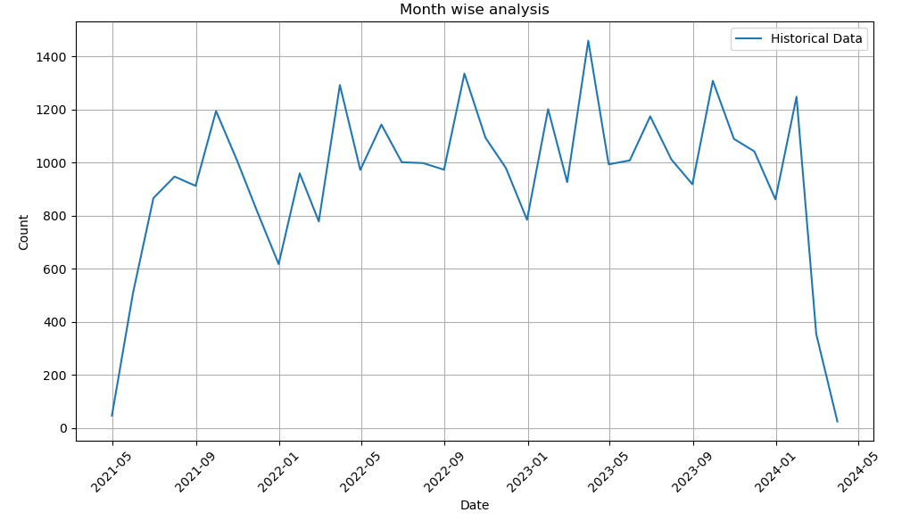
Data Collection and Initial Filtering
Source: Raw data received via email
Process: Initial review in Excel, removal of corrupted and partial records
Storage: Uploaded cleaned data to MySQL

Slide 5
Problem Understanding and Structuring
Defined key steps: Data exploration, model selection, tuning, visualization
Goal: Accurate forecasting insights by brand and model

Slide 6
Exploratory Data Analysis (EDA)
Analysis: Identified patterns, corrected inconsistencies in brand/model columns
Outcome: Ensured data accuracy for better model performance

Slide 7
Model Selection and Testing
Models Tested: AR, MA, ARMA, ARIMA, auto ARIMA, PMDARIMA, Prophet.
Best Fit: Prophet model for highest forecasting accuracy

Slide 8
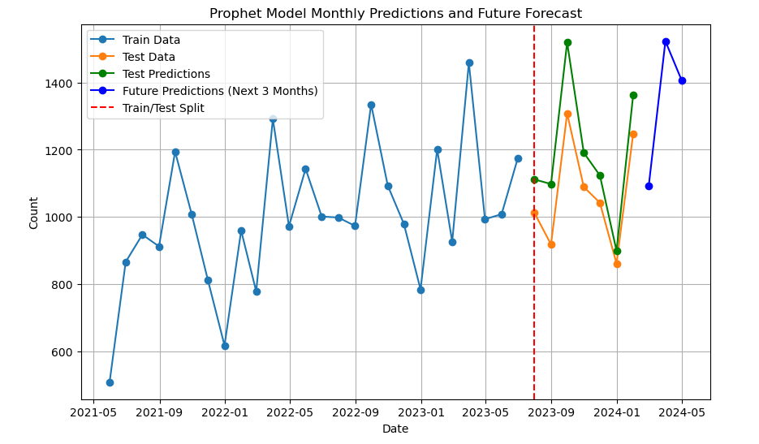
Model Training and Testing

Slide 9
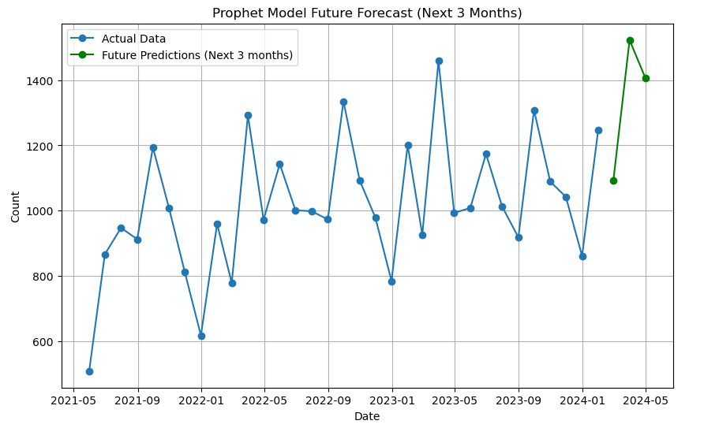
With Whole Data as Training

Slide 10
Model Tuning and Optimization
Adjusted Prophet parameters for seasonality and trend capture
Result: Improved accuracy in three-month forecasts

Slide 11
Results Storage and Visualization
Final model results saved in MYSQL for easy access.
Adjusted output format for seamless integration with PowerBI
Enabled clear and actionable insights through dashboard visualization

Slide 12
PowerBI Dashboard Overview
Historical Sales Trends: Analysis of past sales data
Current Sales Snapshot: Latest figures overview
Three-Month Forecast: Predicted sales for next three months
Location Insights: Car distribution across sites

Slide 13
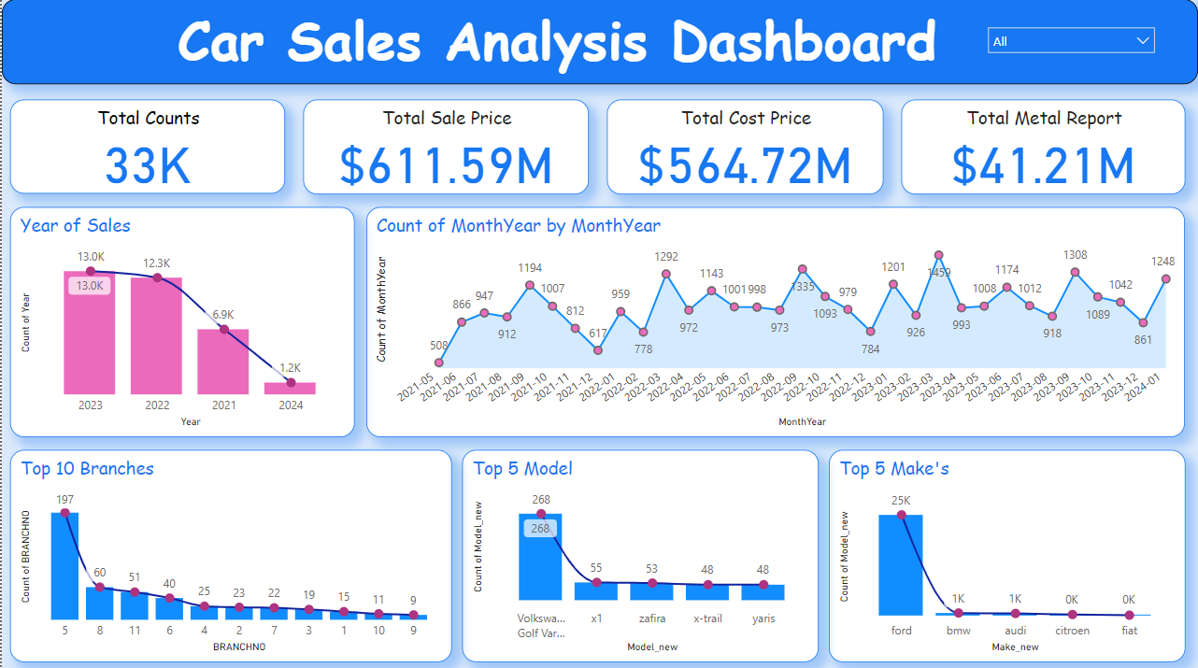
Sales Data Analysis – A breakdown of historical sales trends.

Slide 14
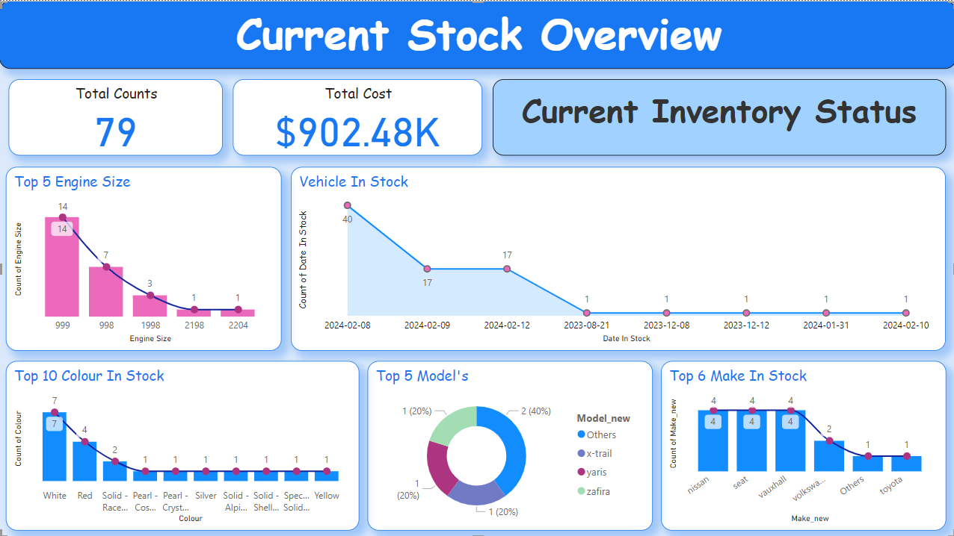
Current Sales Overview – Provides a snapshot of the latest sales figures.

Slide 15
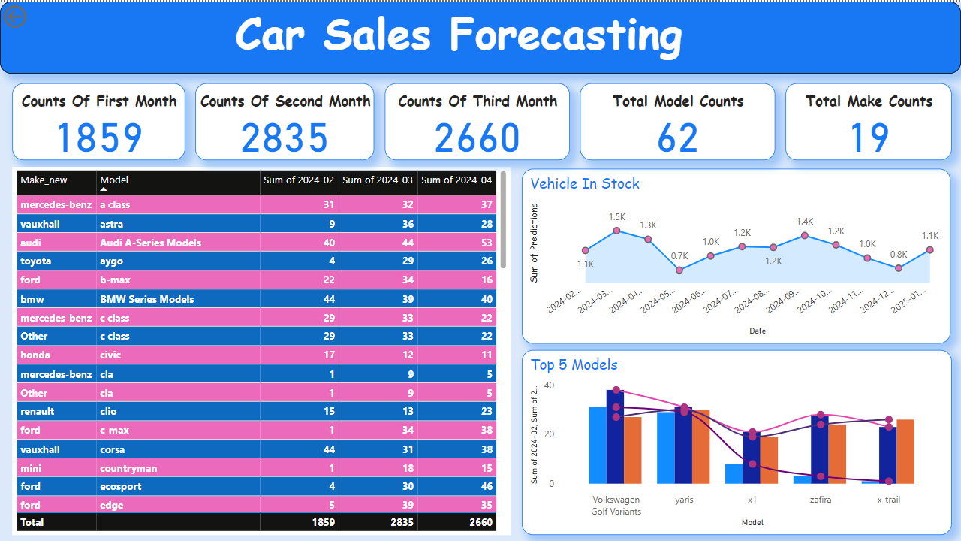
Three-Month Forecast – Presents the forecasted sales counts for the next three months.

Slide 16
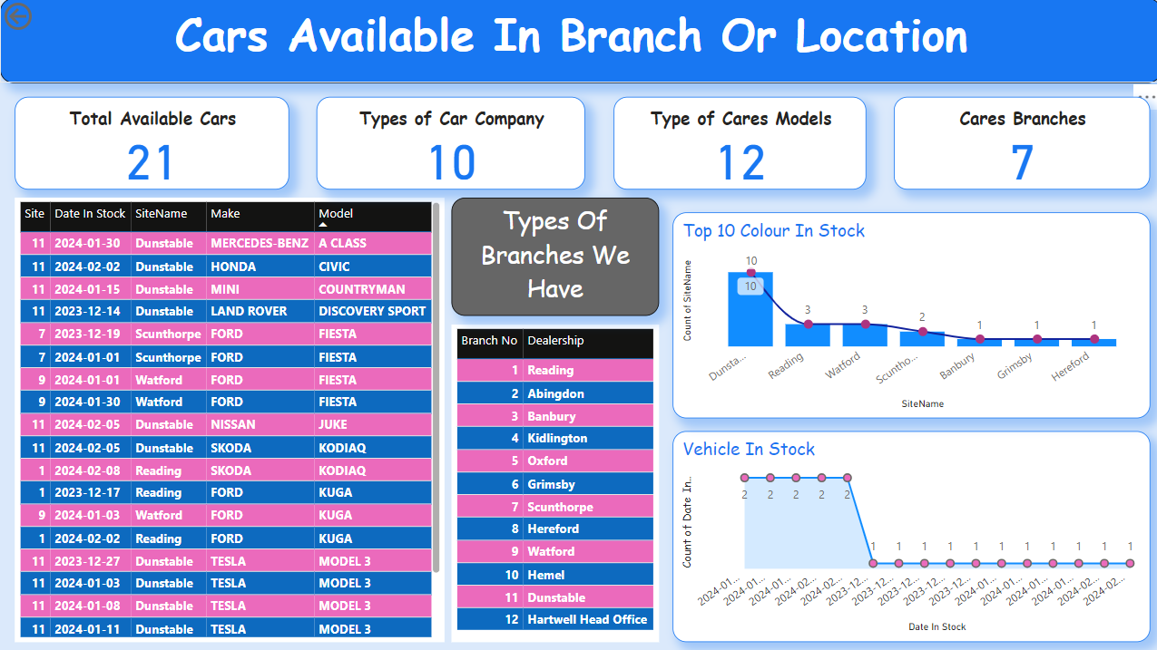
Car Location by Site/Branch – Maps car locations across different sites or branches for operational insights.

Slide 17
Conclusion
Outcome: Reliable sales forecast with detailed breakdowns
Future Steps: Continuous model monitoring and improvement

Slide 18
THANK YOU

